Slide 1


EXPLORATORYDATAANALYSIS ON AMCAT DATA

Slide 2
About me
My name is Masani Vignesh (IN9240355). I am currently pursuing a B.Tech in Computer Science Engineering with a focus on data science.
As a passionate data enthusiast, I am dedicated to acquiring a diverse set of skills that will enable me to excel in the data science domain.
During my three-month internship at Innomatics Research Labs, I worked as an Advanced Data Analyst, where I gained hands-on experience analyzing AMCAT report data.
Linkedin : = https://www.linkedin.com/in/vigneshmasani/
Github: = https://github.com/itzmevig

Slide 3
Objective of the project:
The goal is to analyze the trends of jobs in the job market in all the domains . On what basis the freshers experienced persons are getting their salary . We need to analyze is there any relation ship between them to get good salary at specific location
Web Scraping – Details:
I have developed this Exploratory Data Analysis project using the online platform – Google colab
Summary of the data:
The dataset was released by Aspiring Minds from the Aspiring Mind Employment Outcome 2015 (AMEO). The dataset contains the employment outcomes of engineering graduates as dependent variables (Salary, Job Titles, and Job Locations) along with the standardized scores from three different areas –cognitive skills, technical skills and personality skills. The dataset also contains demographic features. It contains around 40 independent variables and 4000 data points. The independent variables are both continuous and categorical in nature. The dataset contains a unique identifier for each candidate.

Slide 4
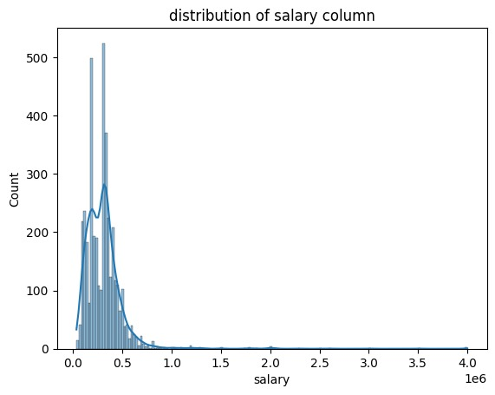
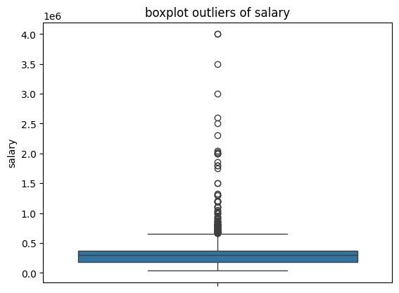
EXPLORATORY DATA ANALYSIS
Data Cleaning - Target Column Distribution:
Distribution of target (salary) column in data set it is right skwed distribution . It has some outliers where some persons are getting more salary then required .

Slide 5
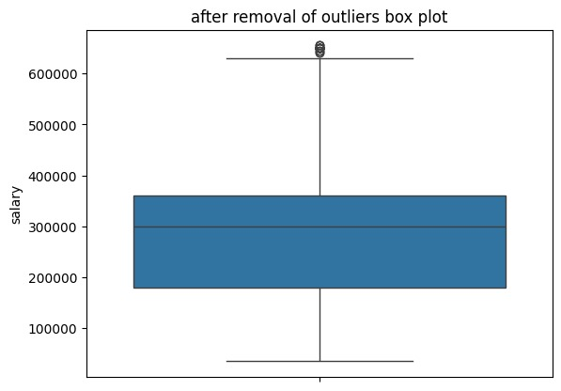
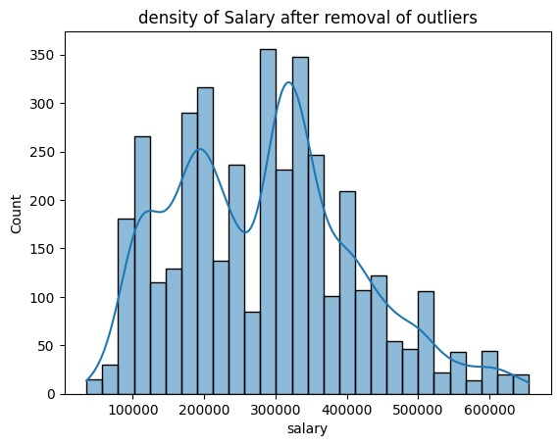
This shows the distribution and density of the salary after the removal of the outliers to prevent deviation due to anomalies in the data.

Slide 6
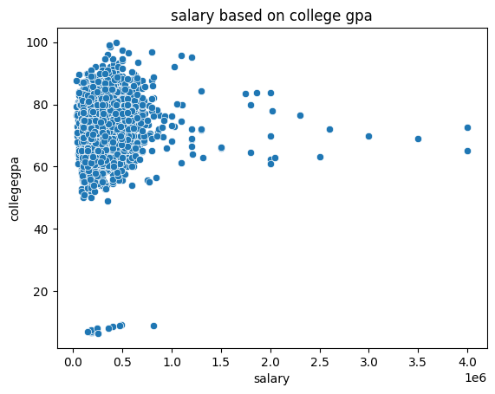
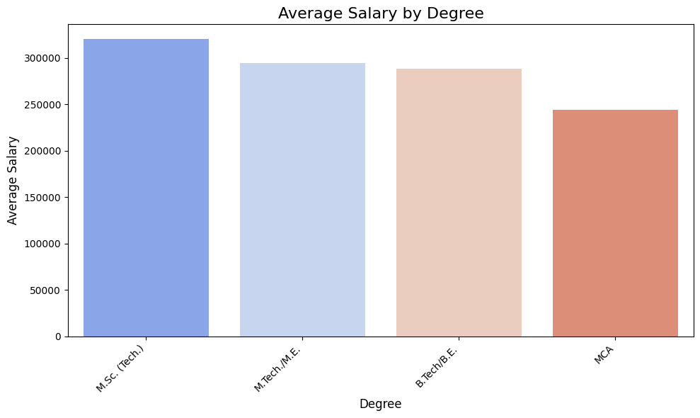
Data Manipulation:
The plot suggests a weak correlation between college GPA and salary. While there are instances of higher salaries corresponding to higher GPAs, many individuals with high GPAs do not have correspondingly high salaries.
The bar chart effectively communicates the differences in average salaries across various degrees.

Slide 7
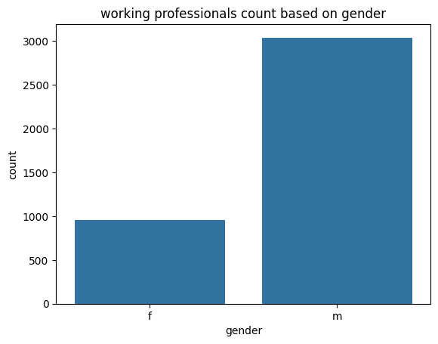
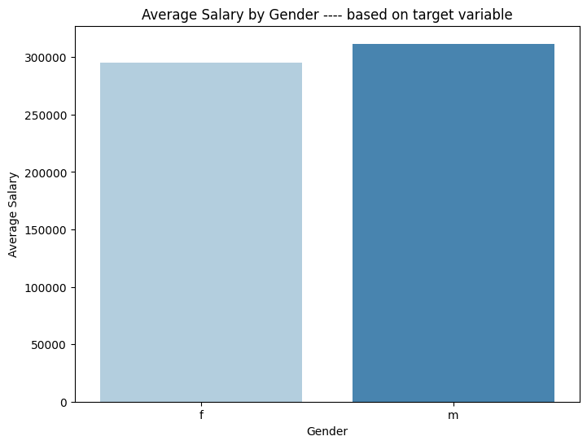
Univariate and Bivariate Analysis:
Count plot shows the count of female working professionals and male working professionals Bar plot shows the average salary of based on gender.
The salary doesn’t based on the gender there is very less difference then gender

Slide 8
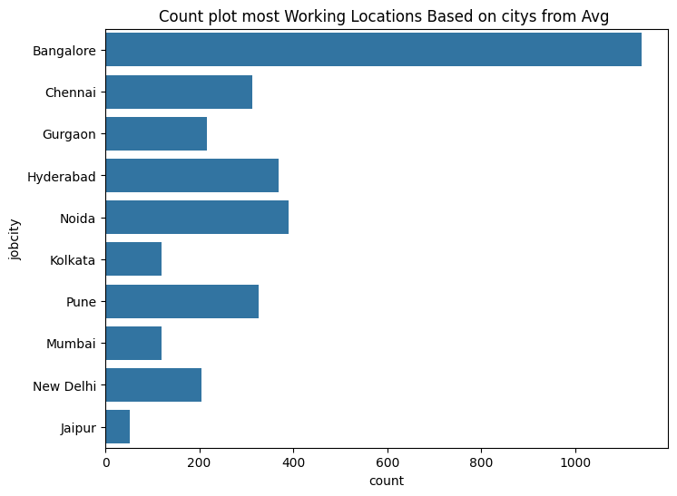
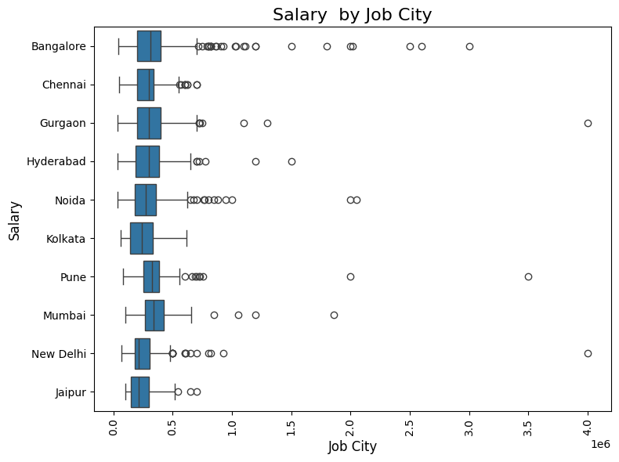
Most of jobs based on the different locations in INDIA

Slide 9
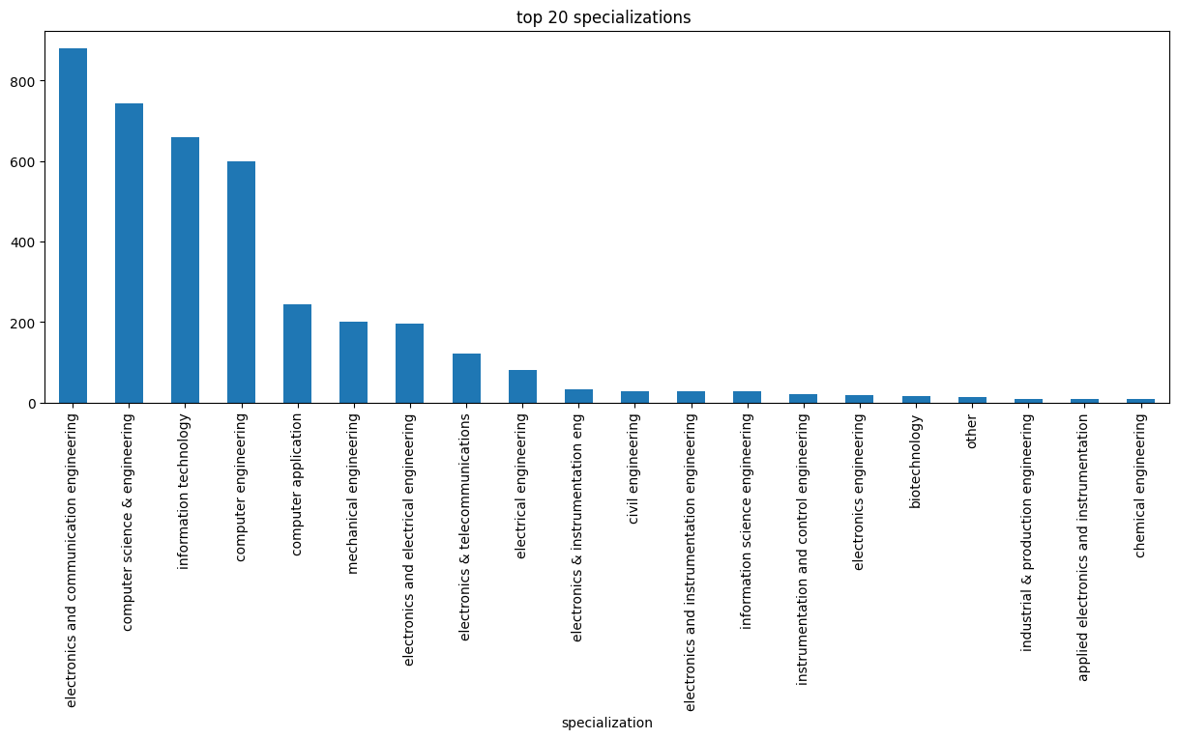

Slide 10
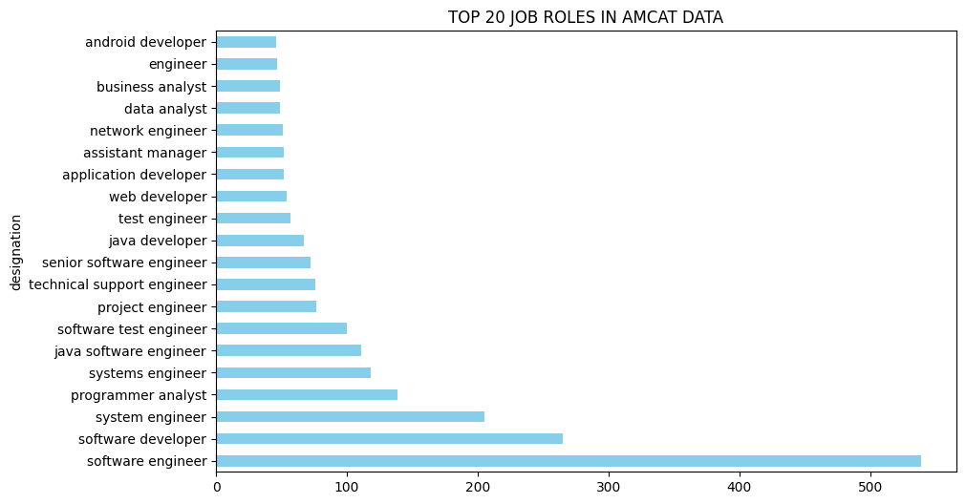
The chart represents the top jobs where the most of freshers are joined or working in that company.

Slide 11
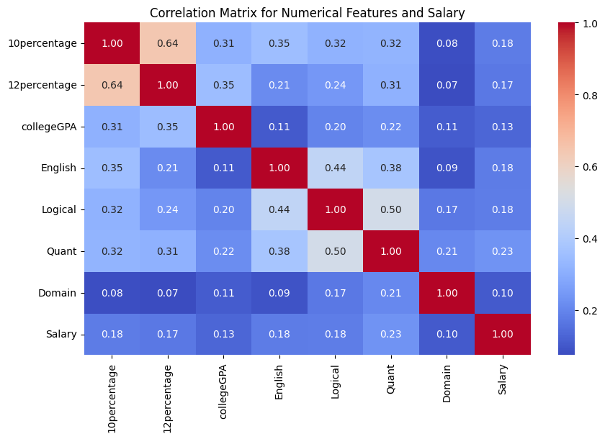
This matrix can help in understanding which academic metrics might be useful predictors for salary and highlight areas where students might focus their efforts to improve their potential earnings.

Slide 12
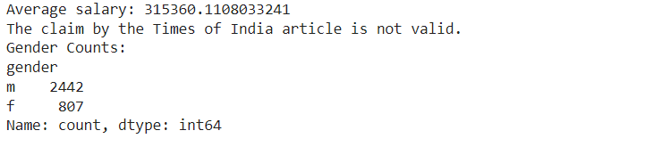
RESEARCH QUESTION:
•Times of India article dated Jan 18, 2019 states that “After doing your Computer Science Engineering if you take up jobs as a Programming Analyst, Software Engineer, Hardware Engineer and Associate Engineer you can earn up to 2.5-3 lakhs as a fresh graduate.”
Test this claim with the data given to you.
•Is there a relationship between gender and specialization? (i.e. Does the preference of
Specialization depend on the Gender?)
:
Solution - Calculation of Average salary:

Slide 13
CONCLUSION
After complete working and implementation of the project, I conclude -
There is no significant relationship between gender and specialization , specialization does not depend on the gender of the individual.
Comparing the average salaries across fields like Computer Science, Mechanical Engineering, or Civil Engineering, we might get which specializations tend to lead to higher salaries and which ones lag behind.
Cities like Bangalore ,Gurgaon and New Delhi might be offer higher salaries compared to smaller cities, even for the same job title and experience level. The location play importance in salary negotiations.

Slide 14

THANK YOU

